Slide 1
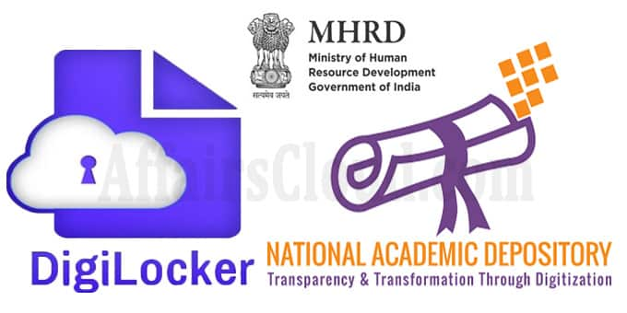

Slide 2
About:
DigiLocker and NAD are initiatives of Ministry of Electronics and Information Technology (MeitY) and Ministry of Human Resource Development (MHRD) respectively.
The concept of National Academic Depository (NAD) is born out of an initiative by MHRD to provide a 24X7 online depository to Academic institutions to store and publish their academic awards.
The digital depository not only ensures easy access to and retrieval of an academic award but also validates and guarantees its authenticity and safe storage.
It aspires to make the vision of Digital Academic awards for every Indian a reality.

Slide 3
Features:
Operates in fully online mode.
Allows Academic Institutions to lodge Academic Awards in digital format and maintains the integrity of the awards.
Allows Students to retrieve their lodged academic awards at any time.
Allows Employers and other persons (with consent of the concerned Student) to verify the authenticity of any Academic Award.
Maintains the authenticity, integrity and confidentiality.

Slide 4
Benefits:
Globally recognized and legally valid awards under IT Act, 2000.
Secure Issuance of Digital Awards in students’ DigiLocker account.
Access to Millions of Digital awards from single source of truth.
Reduces and Eliminates circulation of fake certificates.
Consent based Online and Reliable Verification process.
No risk of losing or spoiling of Academic awards.
Easily sharable & verifiable with anybody.

Slide 5
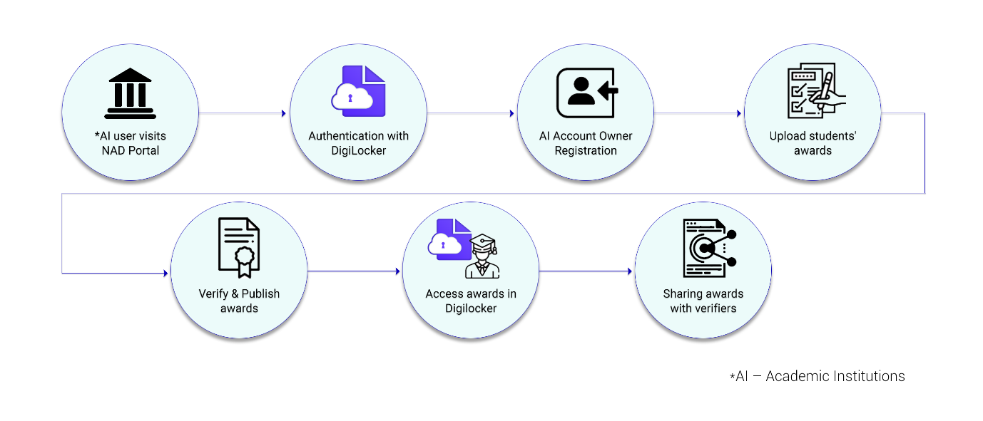
How it works?

Slide 6
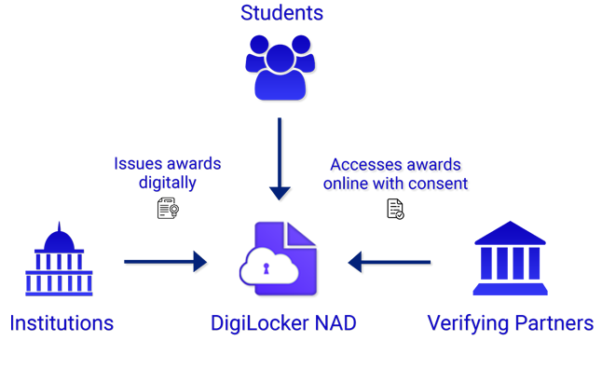
DigiLocker:
DigiLocker aims at promoting Paperless Governance by issuing authentic digital documents issued by various issuers to citizens locker account.
The issued documents in DigiLocker system are deemed to be at par with original physical documents as per Rule 9A of the Information Technology (Preservation and Retention of Information by Intermediaries providing Digital Locker facilities) Rules, 2016.

Slide 7
Ecosystem
The DigiLocker ecosystem comprise of three stake holders i.e., Academic Institutions, Students and Verifying Partners.
DigiLocker is available on web and mobile app for students for accessing, viewing and sharing academic awards. The Academic Institutions will issue digital Awards to DigiLocker through National Academic Depository provided by DigiLocker .
The Institution issuing the document to DigiLocker system is the custodian of these awards and manages the awards throughout its lifecycle.
The Verifying Partners (Employers, Banks, VISA Consulates, Academic Institutions etc.) can easily verify academic awards of the Students through the system by obtaining the consent.

